Slide 1
Distributed Differential Privacy
Applied in Federated Learning
最後一組
M11215032 葉品和 M11215052 陳奕帆 M11215066 鄭宜珊

Slide 2
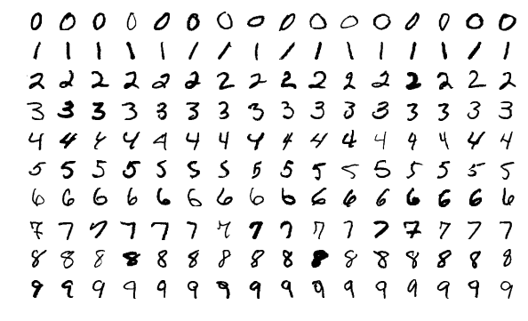
Dataset : Mnist

Slide 3
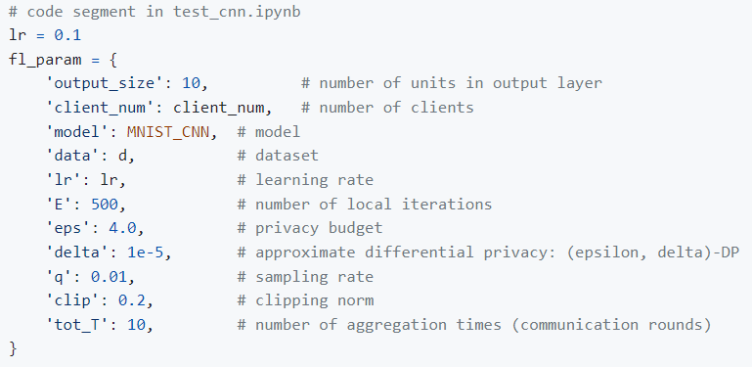
How do you perturb the data?
‘client_num’ sets the number of clients: n.
‘eps’ sets the privacy level ε.
https://github.com/Yangfan-Jiang/Federated-Learning-with-Differential-Privacy/tree/master

Slide 4
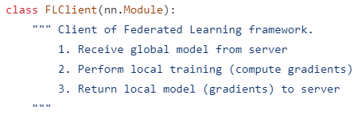
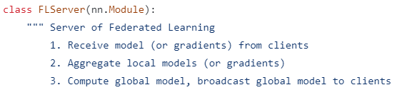
How do you perturb the data?
Divided into FLClient and FLServer, each client will get the same model from the Server and unify the initialization parameters of the model. Repeat the following steps to train the model：

Slide 5

How do you perturb the data?
a. Each Client uses its own data to train the model, calculates its own gradient, and then uploads it to the Server.

Slide 6
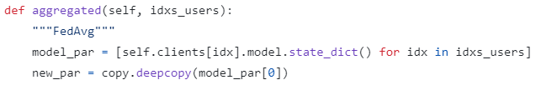
How do you perturb the data?
b. The Server integrates the gradients of each Client and updates the model.

Slide 7
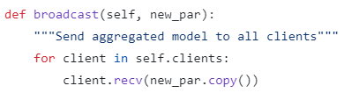
How do you perturb the data?
c. Server returns the updated gradient of the model to each Client.

Slide 8
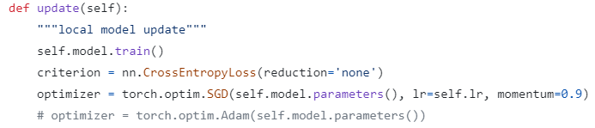
How do you perturb the data?
d. Clients update their respective models.

Slide 9
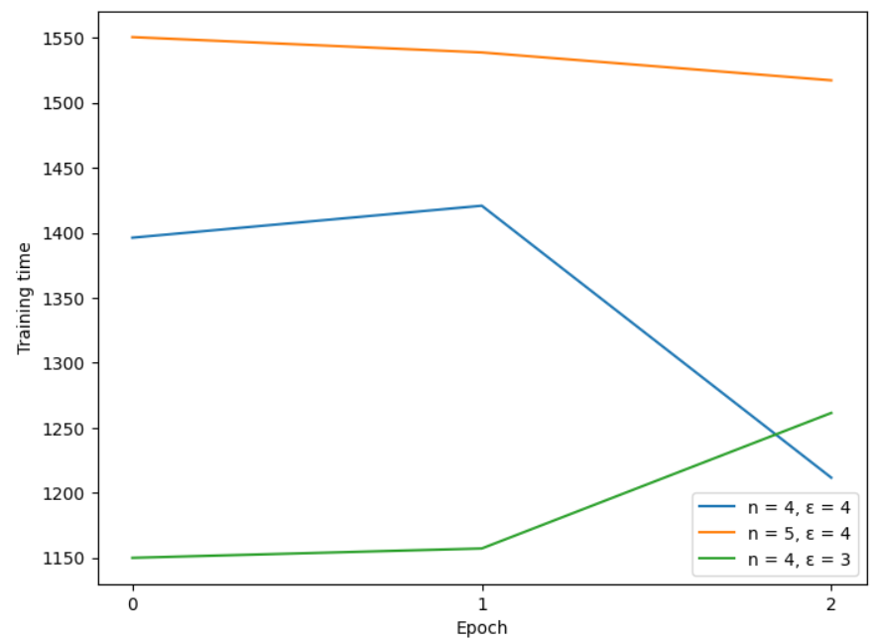
Training Time
Since the training time of each epoch is very long, we do not train too many epochs. The following figure shows the training time of each epoch.

Slide 10
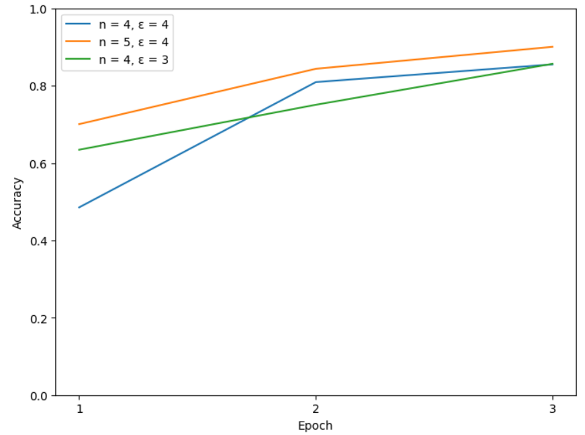
Effectiveness measure: Accuracy
learning rate = 0.15, epoch = 3, delta = 1e-5, sampling rate = 0.01

Slide 11
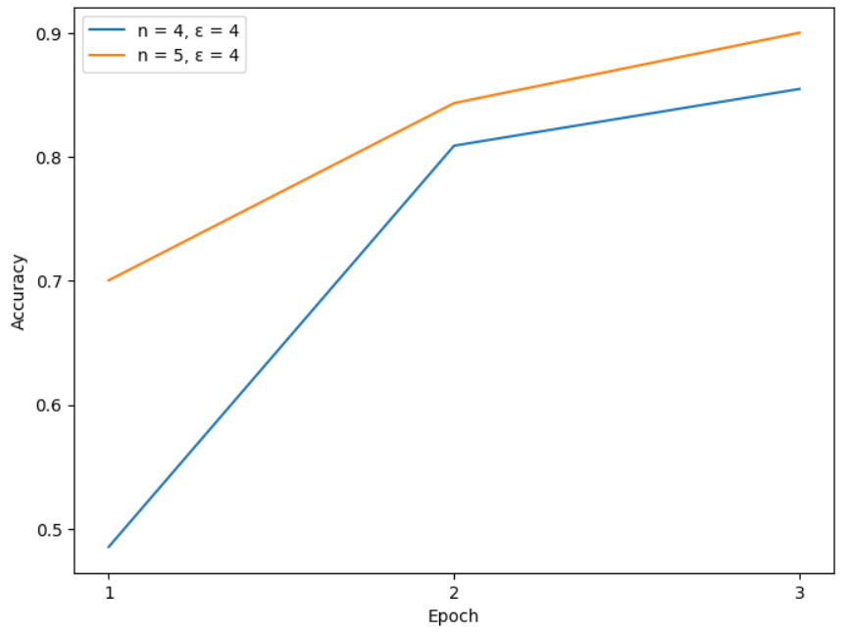
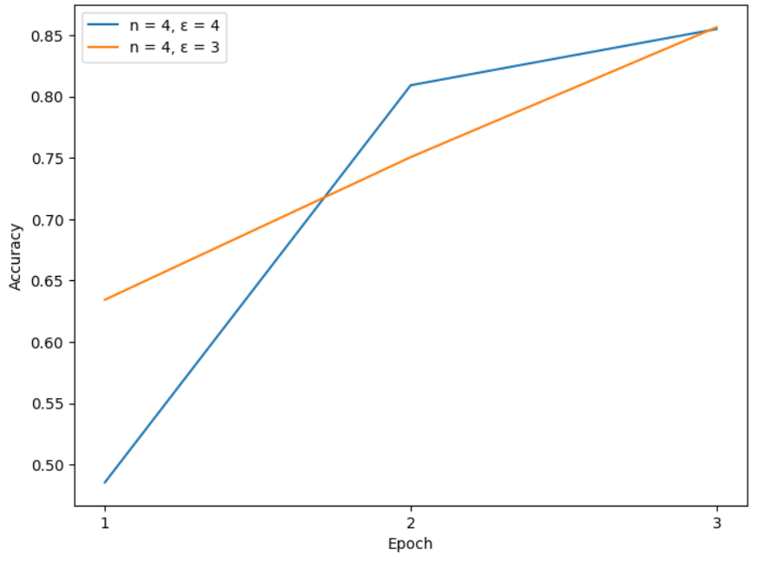
Privacy level: the value of ε & Number of clients: n
learning rate = 0.15, epoch = 3, delta = 1e-5
sampling rate = 0.01, ε = 4
learning rate = 0.15, epoch = 3, delta = 1e-5
sampling rate = 0.01, n = 4

